Slide 1


Lab 12
FIT5202 Big Data Processing
Data Streaming using Apache Kafka and Spark
Spark Structured Streaming
Aggregations on Windows over event-time
Handling Late events with watermarking

Slide 2



Lab 11 Agenda
•
Lab 10 Review
•
Structured Streaming
•
Integration with Kafka
•
DEMO
•
This Week:
•
Aggregations on Windows over Event Time
•
Handling late data with watermarking
•
“Parquet” sink
•
Checkpointing

Slide 3
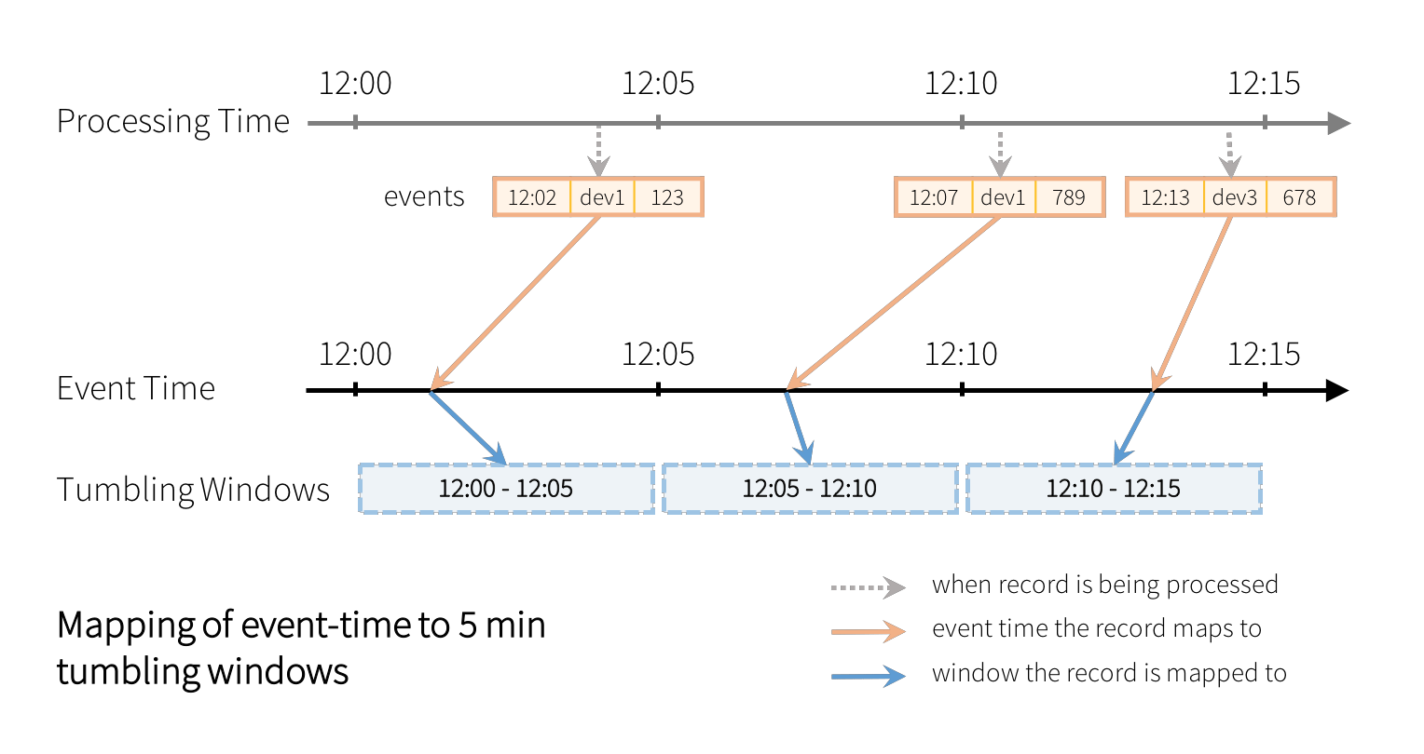

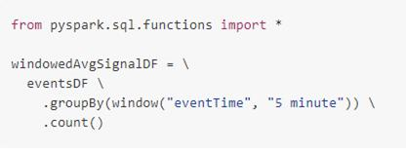
Aggregations on Windows over Event Time
❑ In many cases (e.g., moving averaging), we want aggregations over data bucketed by
time windows (e.g., every 5 minutes) rather than over entire streams
❑ Bucketing data into windows based on event-time (e.g. the time data generated in the
producer) – grouping using window function
Non-overlapping windows
https://databricks.com/blog/2017/05/08/event-time-aggregation-watermarking-apache-sparks-structured-streaming.html

Slide 4
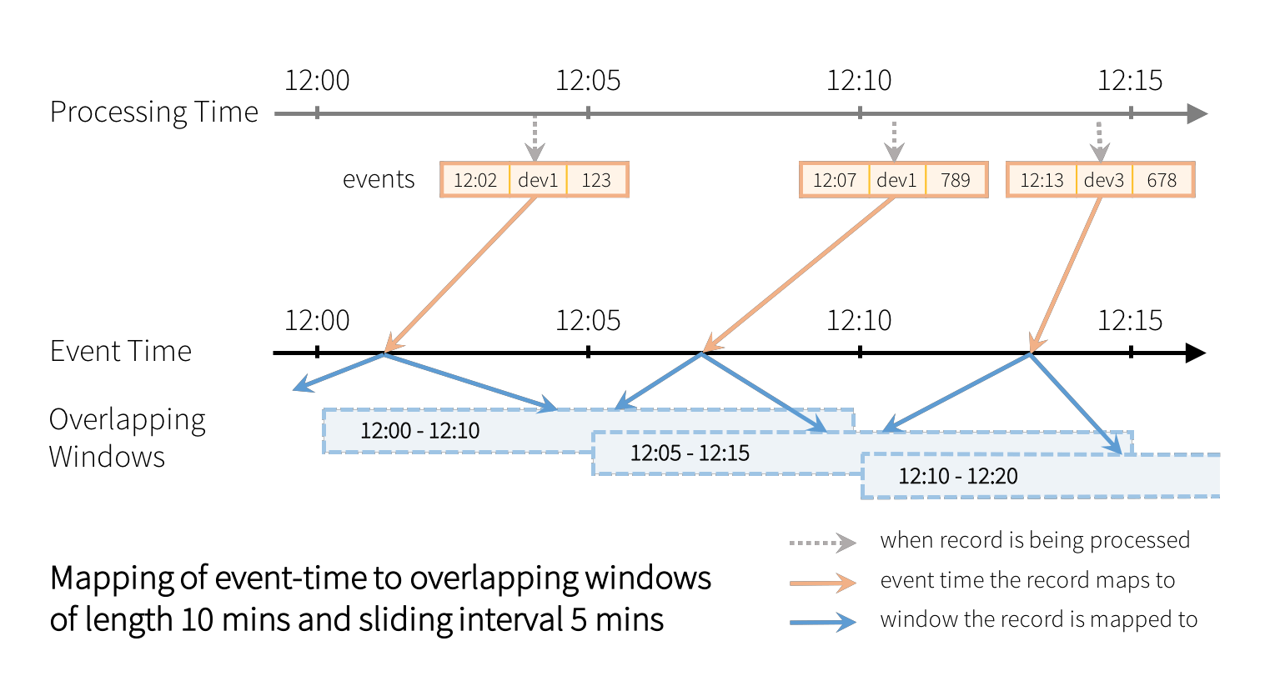

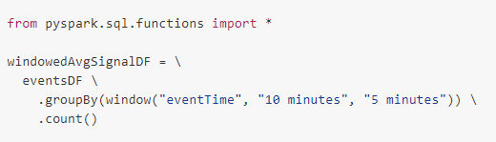
Aggregations on Windows over Event Time
Overlapping windows

Slide 5
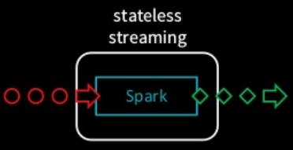
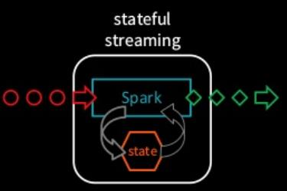
Stateless vs Stateful Stream Processing
State of Progress
❑ keeping track of data that
Stateful
has been processed in
Stateless
❑ Processing of records depends
streaming so far.
❑ Each record is processed
upon the result of previously
❑ Called
independently of other
processed records.
checkpointing/saving of
records
offsets of incoming data.
❑ Need to maintain “intermediate
❑ e.g. operations like map, filter,
information” for processing –
join with static data
called “state”
State of Data
❑ E.g., operations like
❑ intermediate information
aggregating count of records
derived from data
(e.g., intermediate count)
(processed so far).
https://medium.com/@chandanbaranwal/state-management-in-spark-structured-streaming-aaa87b6c9d31

Slide 6
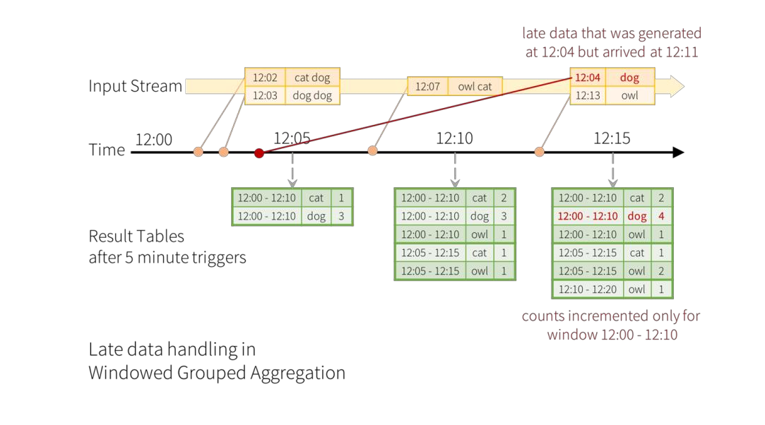
Watermarking
Structured Streaming can maintain the intermediate state for partial aggregates (e.g. intermediate
count) for a period of time such that late data can update aggregates of old windows correctly
•
To handle events that arrive late to the
application
•
E.g. a word is generated at 12:04 (event time)
but received at 12:11 by the application.
•
The application should use the time 12:04
instead of 12:11 to update the older counts for
a window 12:00 - 12:10.
•
Watermarking lets engine automatically track
the current event time in data and clean
up/update old state accordingly

Slide 7
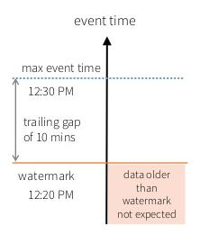
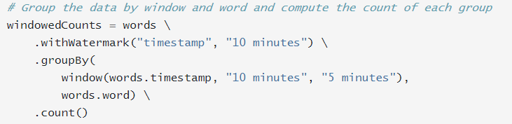
Watermarking
Two parameters to define the watermark of a query
(1)
event time column
(2)
Threshold specify for how late data should be
processed (in event time)
max event time - is the latest
late data within the threshold will be aggregated, but data
event time seen by the engine
later than the threshold will start getting dropped
https://towardsdatascience.com/watermarking-in-spark-structured-streaming-9e164f373e9

Slide 8
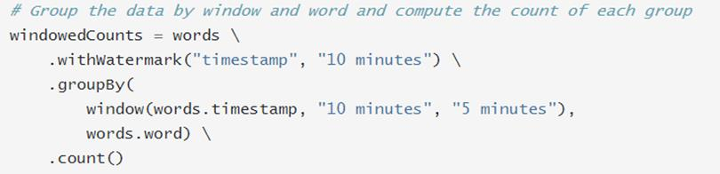
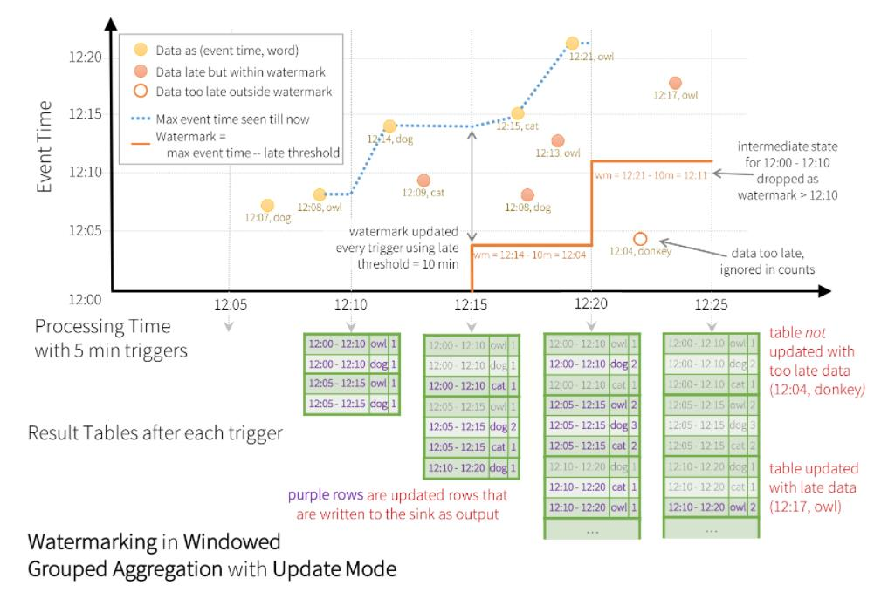
Window-based aggregation
Watermarking
based on event time –
Window size = 10 mins
Slide = 5 mins
❑ Engine will keep updating counts of
a window in the Result Table until
the window is older than the
watermark, which lags behind the
current event time by 10 minutes.

Slide 9
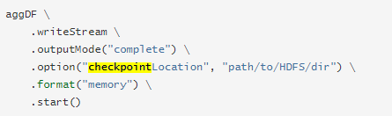
Recovering from Failures with
Checkpointing
•
In case of failure, can recover the previous
progress and state of previous query and
continue where it left off.
•
Can enable checkpointing using the option
checkpointLocation on the query.
•
To save all the progress information (i.e.
range of offsets processed in each trigger)
and the running aggregates (‘states’) to the
checkpoint location

Slide 10



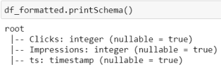
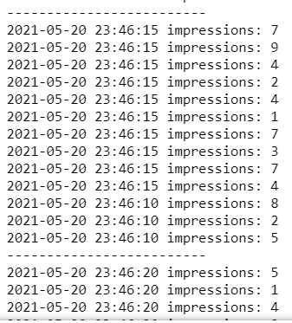

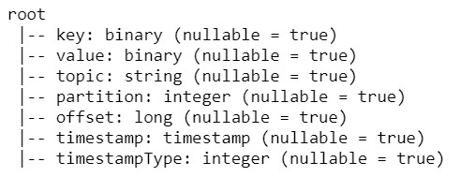


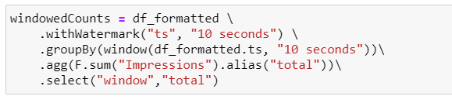
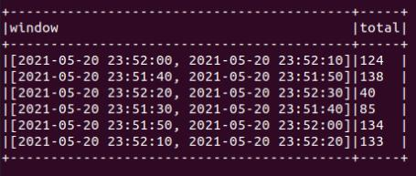
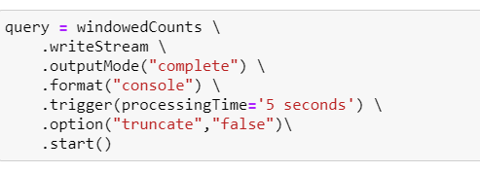
Clickstream Watermarking
Using the schema,
we convert the
data to a Spark
DataFrame
Kafka producer
Cast to String
Parse the string data in json
Late events
format according to the schema
Clicks
Impressions
ts
0
6
1602944650
0
10
1602944650
Spark subscribe to topic &
0
5
1602944650
read data
Aggregations on Windows over
Output result table
Event-time
For aggregation query,
use ‘complete’ mode

Slide 11
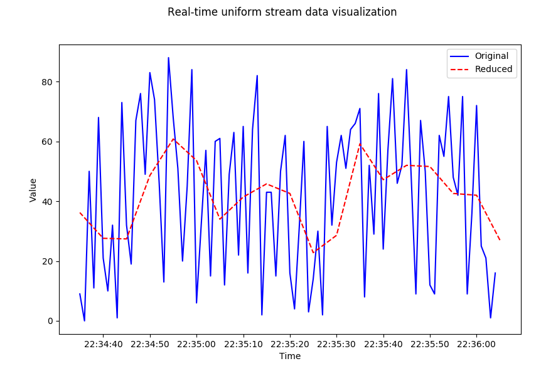
Granularity Reduction DEMO
(Refer to Lecture)
The Aggregation on Windows over
Event-time is another way of
understanding the concept of granularity
reduction.

Slide 12
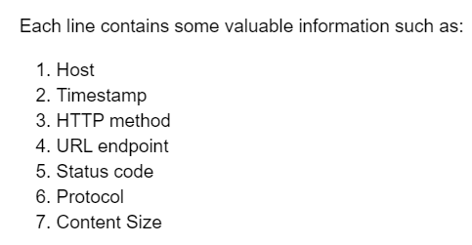
Lab Task: Access Log – Window-based Aggregation
tsExp=r'(\d{10})\s‘
Aggregations on window over event-time
- Extract event timestamp
Data preparation
logs/access_log.txt
Aggregation on window
Kafka Producer
access_log
Spark Streaming
Output sink (Console)
Append with event time, ts
Task 1:
❑ Using the Window function, find the number of logs for each
status in a window of 30 seconds. Set the window slide to 10
seconds
❑ Write the output to console sink.

Slide 13
References
Event-time Aggregation and Watermarking in Apache Spark’s Structured Streaming | Databricks Blog
Structured Streaming Programming Guide - Spark 3.5.0 Documentation
https://docs.databricks.com/spark/latest/structured-streaming/production.html
Introduction to Spark Structured Streaming - Part 7 : Checkpointing State

